Slide 1
Driver Rating system using Deep Learning
Submitted By:
Amit Gussain
Arvind Rawat
Himanshu Pal
Lalit
Under the Guidance of:
Dr. Indrajeet Kumar

Slide 2
Introduction
As per the WHO (World Health Organization), more than 1 million people die due to traffic accidents worldwide per year, making it one of top 10 leading causes of death and around 30 million people are injured from such accidents.
This application is designed to rate the drivers on the basis of the distraction activity.
Driver distraction is basically defined as the activity in which the driver losses the focus from driving and gets indulged in another activity like talking to phone, reaching behind etc.

Slide 3
MODULES
Front-end
Backend
1. Login and Register
2. Integration of Deep learning Model
3. Driver Profile
Deep learning Model
1. Searching and Downloading Dataset
2. Planning Technology to be used
3. Implementation and Improvements in Accuracy and Loss function.

Slide 4
Technology Used
This project is developed using the deep learning technology.
Deep Learning is a subset of Machine Learning which is inspired by the working of human brain.
It uses the neural network and representation learning.
This project uses CNN(Convolutional Neural Networks) to classify the images of drivers and then decide whether the driver is distracted or not.
Next slide shows all the classes in which the images can be classified.

Slide 5
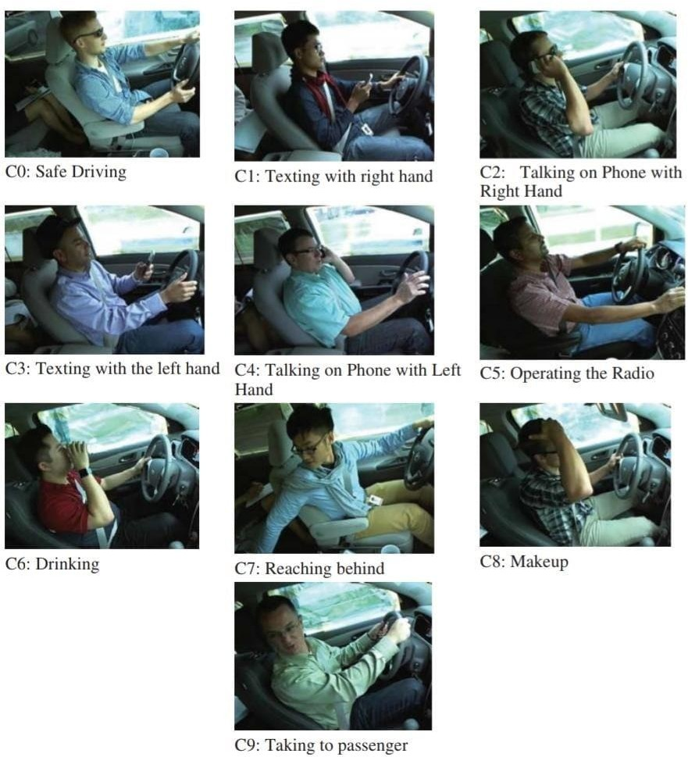
CLASSES of IMAGES

Slide 6
DATASET USED
This project uses the Kaggle State Farm distracted driver dataset.
The dataset contains 102152 images and the size is 4.31GB.
This dataset contains images from all the classes as defined in the previous slide.
BELOW IS THE LINK:
https://www.kaggle.com/competitions/state-farm-distracted-driver-detection/data

Slide 7
CNN(Convolution Neural Networks)
A deep CNN is a type of artificial neural network. Deep CNNs are motivated by the animal visual cortex. Currently, for several recent years, CNNs have demonstrated tremendous achievements in various applications, e.g., image classification, object and action detection, and natural language processing
The performance of CNN is more powerful than ANN when it comes to identifying images and objects.
Layers in CNN:
1. Input layer
2. Convolution layer
3. Pooling layer
4. Fully Connected layer
5. Output layer

Slide 8
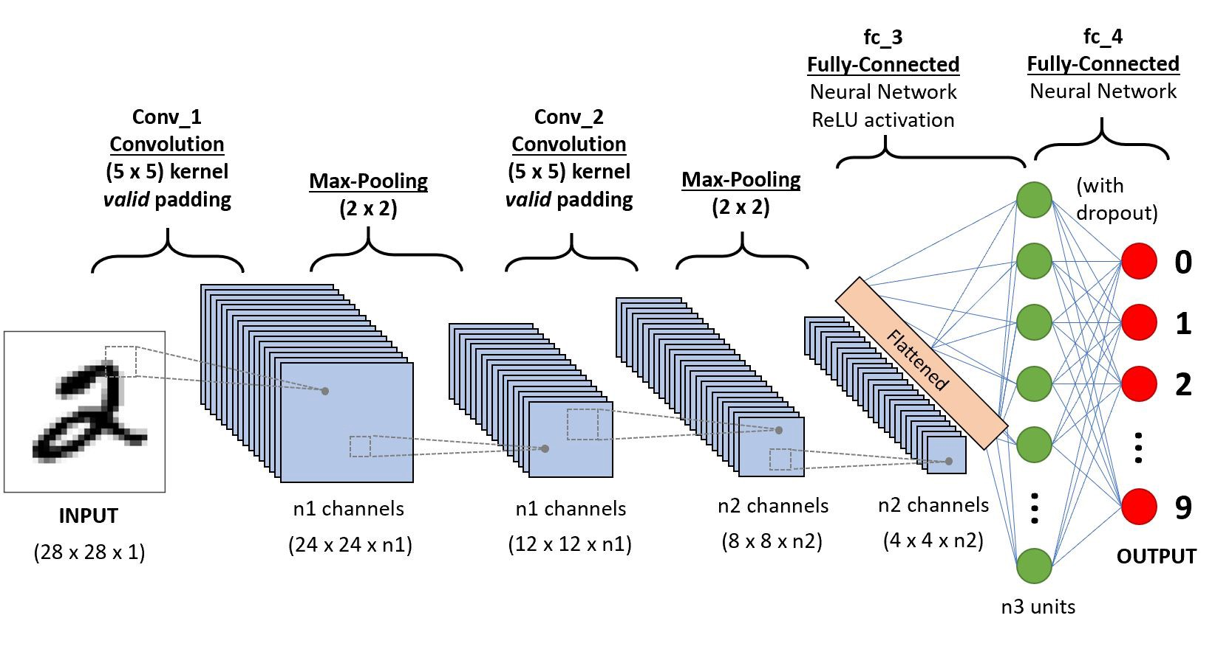
CNN Architecture

Slide 9
Frameworks And Libraries
Flask: widely used for backend web development using python
Tensorflow: deep learning models directly of by wrapper libraries.
Keras: wrapper library used to implement CNN.
Matplotlib: Analysis of model and data engineering by using graphs.
Pandas: Working with datasets.
Numpy: Performing operations on large data.
Pymysql: Connectivity with mysql.
Flask-mysqldb: used for connecting with myql database.

Slide 10
Front-end Description
The frontend is developed using HTML, CSS and Javascript.
The frontend of the application consists of a Home page which introduces the visitors with application and contains link for the login and register button.
Each driver can register and login to it’s portal. Driver portal provide all the information about the driver.
There’s a driving mode in the portal which redirects the driver to the distraction detection mode.

Slide 11
Backend Description
This part is designed using flask framework in python.
The backend part is divided into several modules like login & register, integration of deep learning model and driver’s profile.
MYSQL database is used for storing each driver’s data and login information.
Integration of deep learning model is done using the keras load_model() function.

Slide 12
Learnings
PYTHON
> Web development using Flask
> Flask and Mysql integration
> Integration of Machine Learning model with web application.
Deep Learning.
> Deep learning Introduction, loss function and gradient descents.
> Neural Networks and their working.
> Convolutional Neural Networks

Slide 13
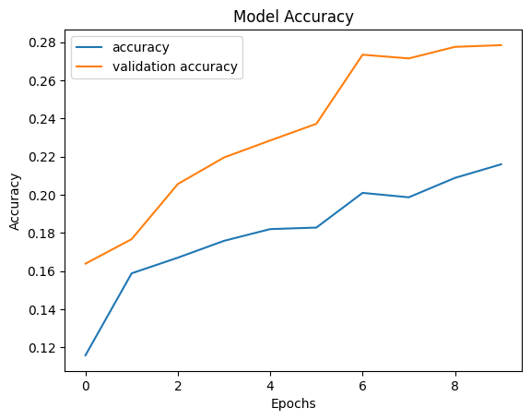
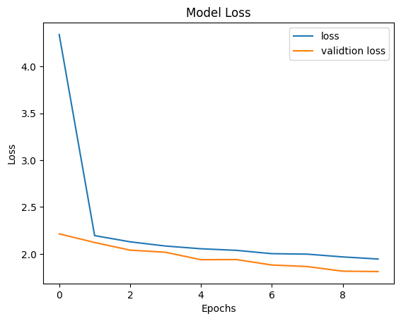
Loss function and Accuracy
MODEL 1:

Slide 14
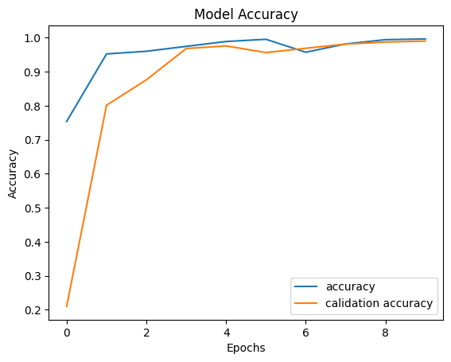
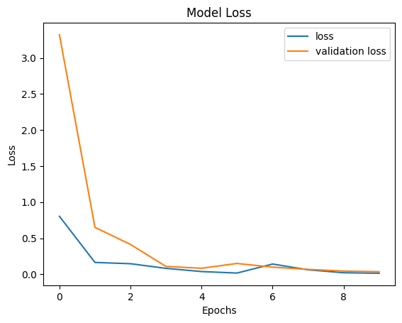
Loss function and Accuracy
MODEL 2

Slide 15
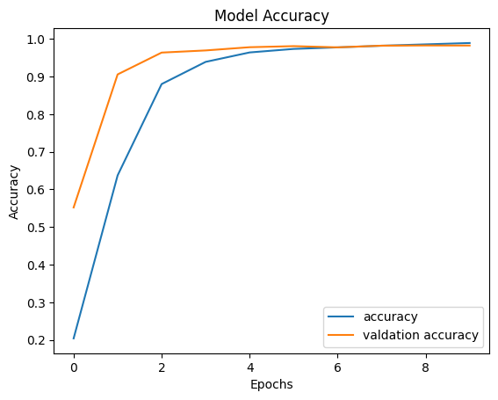
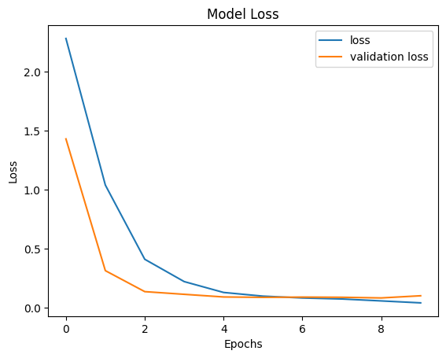
Loss function and Accuracy
MODEL 3:

Slide 16
THANK YOU

